Slide 1
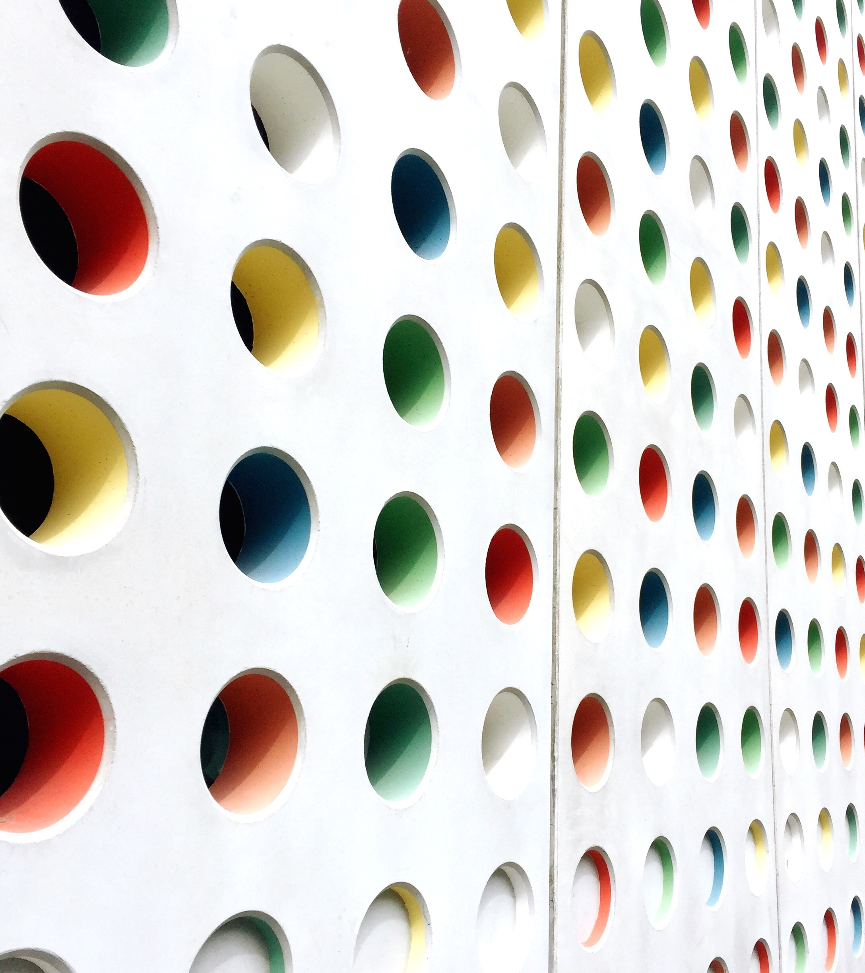
Supermarket Store Branches Sales Analysis
By Akosua Krofa

Slide 2
Context
A supermarket is a self-service shop offering a wide variety of food, beverages, and household products, organized into sections. This kind of store is larger and has a wider selection than earlier grocery stores but is smaller and more limited in the range of merchandise than a hypermarket or big-box market. In everyday U.S. usage, however, "grocery store" is synonymous with supermarket, and is not used to refer to other types of stores that sell groceries.

Slide 3
Basic Findings
There are 896 unique stores and 616 unique products/items available.
The mean daily customer count and mean store sales is 786 and 59,351.30 dollars respectively.
Respectively, maximum daily customer count and store sales value is 1,560 and 116,320 dollars.
The minimum number of customers in a day per month is 10 and the least daily sales is 14,920 dollars

Slide 4
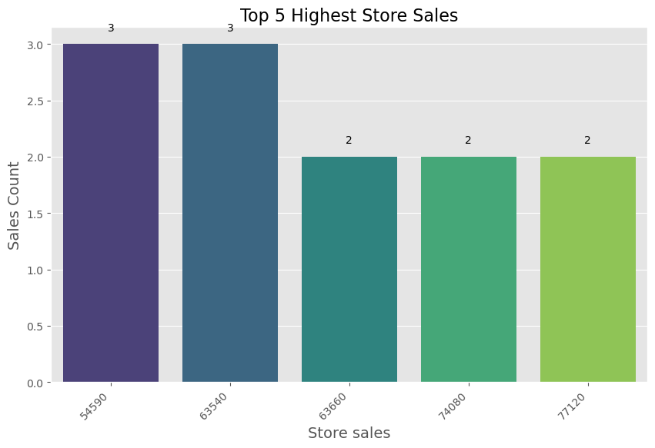
Basic Findings
The top 5 store sales are 54590, 63540, 63660, 74080 and 77120. These sales are recorded by 3, 3, 2, 2 and 2 stores respectively

Slide 5
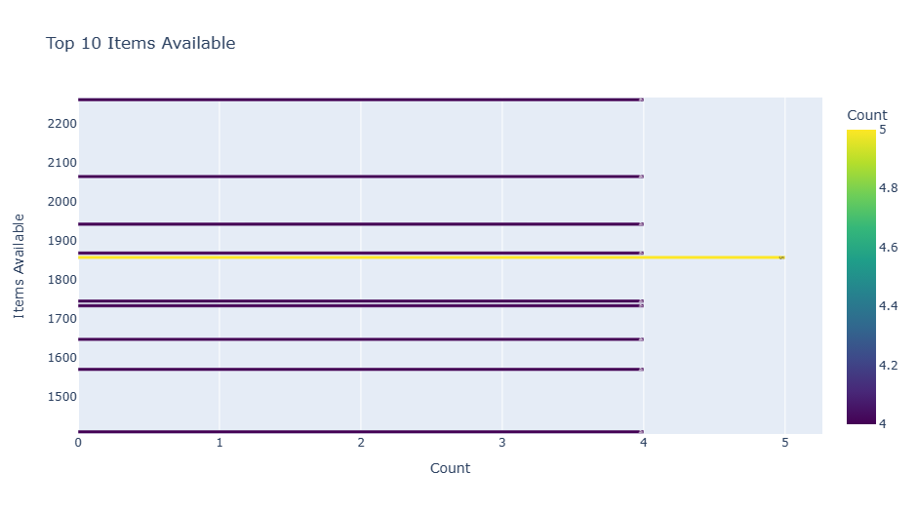
Basic Findings
Items available in each store ranges from 1,000 to 2,500 with the highest count being 1858 items. There are 5 stores with this number of items available. The data shows that of the top 10 stores which have a large variety of items, five stores have 1,858 items available and this is the largest variety of items in any given store. Four stores have the following items available 1,411 1,571 1,648 1,734 1,746 1,869 1,943 2,065 and 2,262

Slide 6
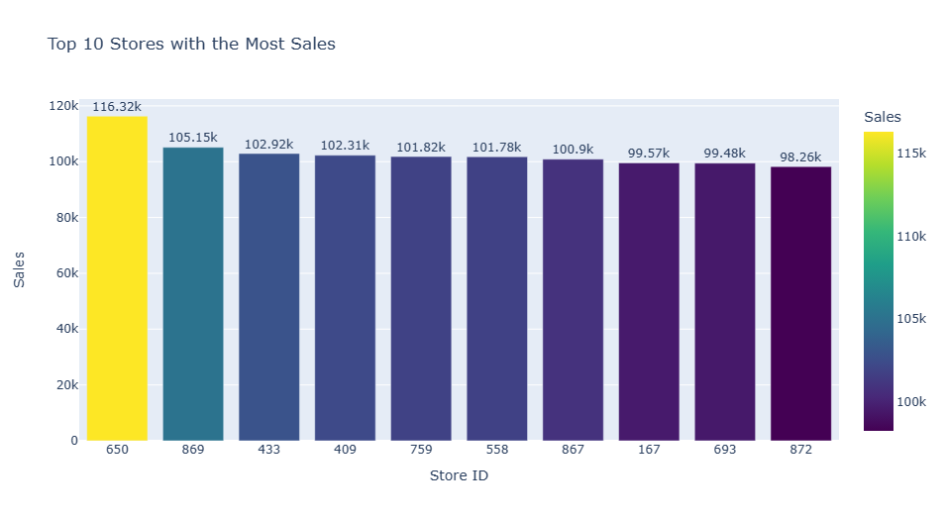
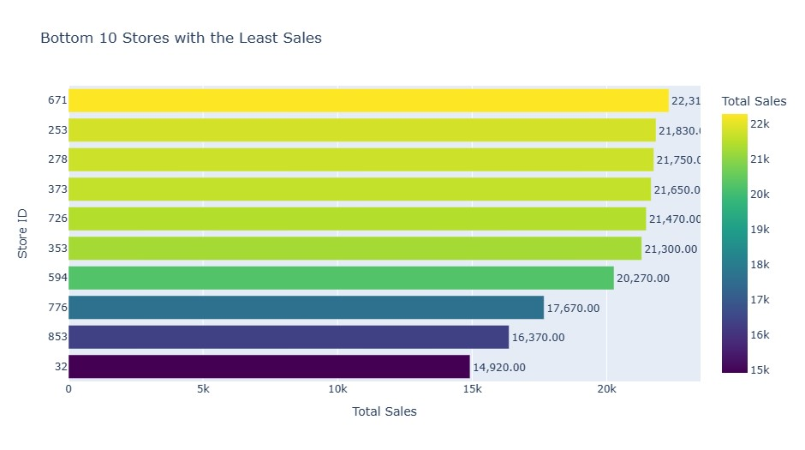
Basic Findings
Considering the top 10 sales figures, the store with ID 650 recorded the highest sales of 116,320 whilst store with ID 872 recorded sales of 98,260 The data further shows the bottom 10 sales per each store. It can be seen that the store with ID 32 recorded the least sales of 14,920 dollars, followed by store ID 853 with revenue of 16,370 dollars

Slide 7
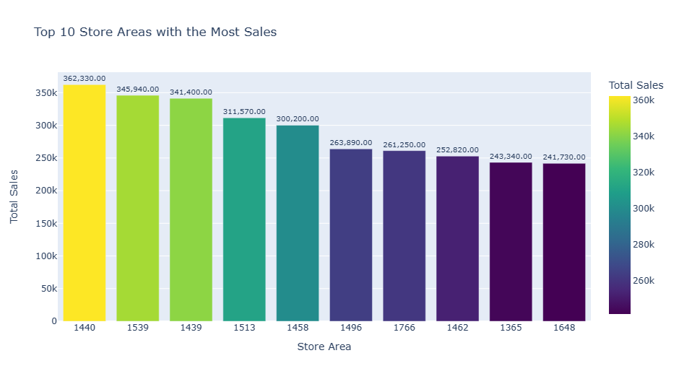
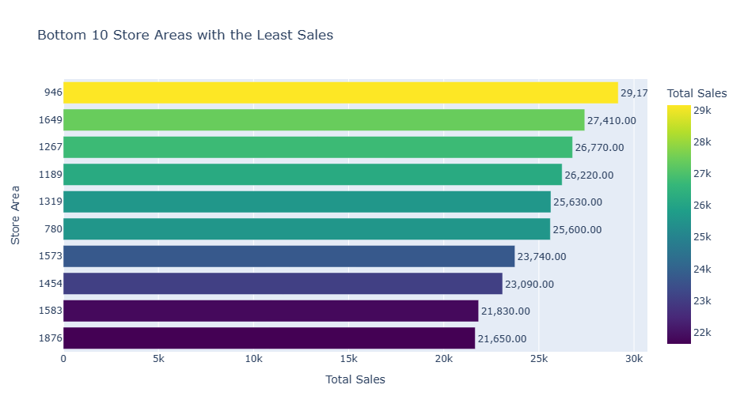
Basic Findings
The range of total sales for the top 10 stores using Store area as the criteria shows total sales ranges between 250k and 370k. Store with area of 1440 sq yds recorded the highest revenue of 362,330 dollars store area 1879 sq yd recorded the least sales of 21,650. The bottom 10 store sales using the bottom 10 stores with area as the criteria have total sales revenue ranging from 21k to 30k

Slide 8
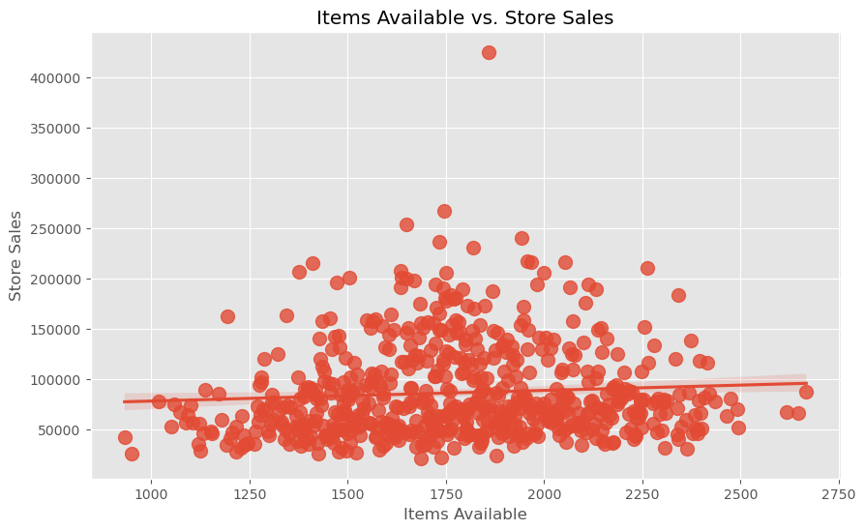
Items Available vrs Store Sales
The below scatter plot shows that total sales revenue is largely between 50,000 dollars and 100,000 dollars
Outliers: Outlying points, those significantly distant from the regression line, may represent unusual or exceptional cases. There is an exceptional case where store sales recorded was above 400,000 dollars and this could be as a result of windfall contract or a nearby event for which significant increase in demand was recorded e.g. campers on camping, marathon etc. There is no record of sales between 300,000 and 400,000

Slide 9
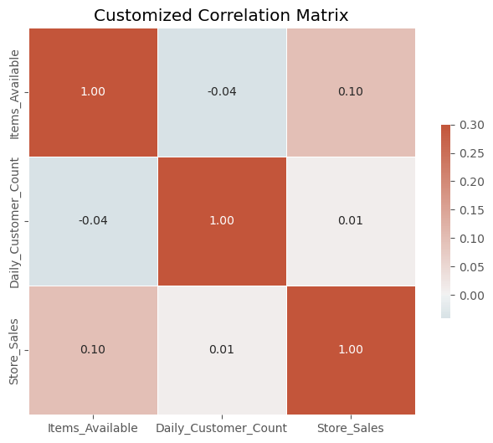
Relationship between Items Available, Daily Customer Count and Store Sales
There is a positive but weak correlation between store sales and Items available and this implies that when the inventory of items in the store is increased the sales of that store increases but not in equal proportion. This could be because a larger proportion of the items in the store are food and beverages and the shelf life of these products is short hence expiring quicker. In this case the stores are running at a loss. There is a much weaker positive correlation between store sales and daily customer count implying that when the daily customer count increases store sales also increases but marginally.
This could be because customers may not find their product of choice in store or the items may be considered expensive. Considering items available and daily customer count, there is a negative correlation. Although weak, it implies that when the daily customer count increases, the items available decreases but marginally showing that to a large degree customers do not patronize the items in store.

Slide 10
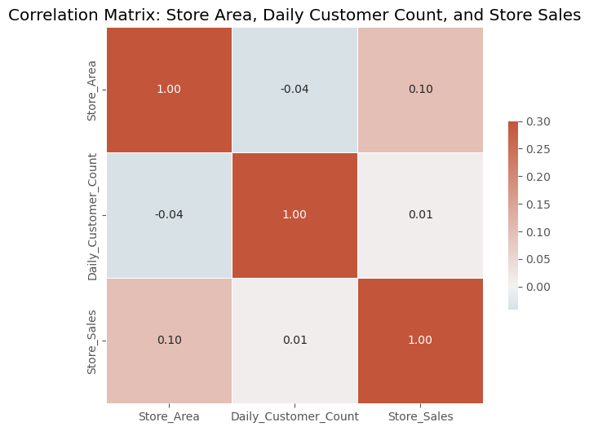
Relationship between Store Area, Daily Customer Count and Store Sales
There is a positive correlation between store sales and store area. This shows that the larger the store the higher the sales recorded. This can be attributed to fact that a larger store can stock more items. The daily customer count however has a negative correlation with store area implying that a smaller store records a higher daily customer count and a larger store records a smaller daily customer count. This negative correlation could suggest the following:
A larger store area might lead to a perception of the store being less crowded, which could deter customers who prefer a more bustling atmosphere
Accessibility: A larger store area might be harder to navigate, making it less convenient for customers to find what they need quickly, potentially reducing the number of daily visits.
Location: It's also possible that larger stores are located in less densely populated areas or have less foot traffic, leading to fewer daily customers.

Slide 11
Recommendations
It can be seen that sales are generally low across the stores although there are 896 unique stores and 616 unique products. The following is recommended:
Variety in Items available: A market survey can be taken to find out the products which customers will like to see in the store (customer preference). This will inform store management of which inventory to stock in the stores. The demographics of the nearby population will each present different needs/preferences
It is advisable for management to consider smaller store sizes so as to make it easier for customers to locate the items they want to purchase. In the larger stores, items which are noticed to be highly patronized can be arranged closer to the cash til so customer do not have to walk around trying to locate items of need to them.
In order to stay profitable in business, items in store should be competitively priced. A survey can be taken of the prices of similar items in other nearby shops to inform what pricing should be used. The survey should include alternative suppliers who may offer discounts or have favorable pricing
To encourage store patronage, promotions can be run from time to time especially when items in store are nearing the end of their shelf life (expiry date)

